Slide 1




JIRA Interview Questions and Answers
Pramod Dutta Lead SDET.
#SDETInterview

Slide 2

What is JIRA?
JIRA is an issue Tracking Product.
Developed by Atlassian.
Jira was designed as a bug and issue tracker.
Allow to bug tracking and Agile Project management.
Jira has evolved into a powerful work management tool for all kinds of use cases, from requirements and test case management to agile software development.

Slide 3
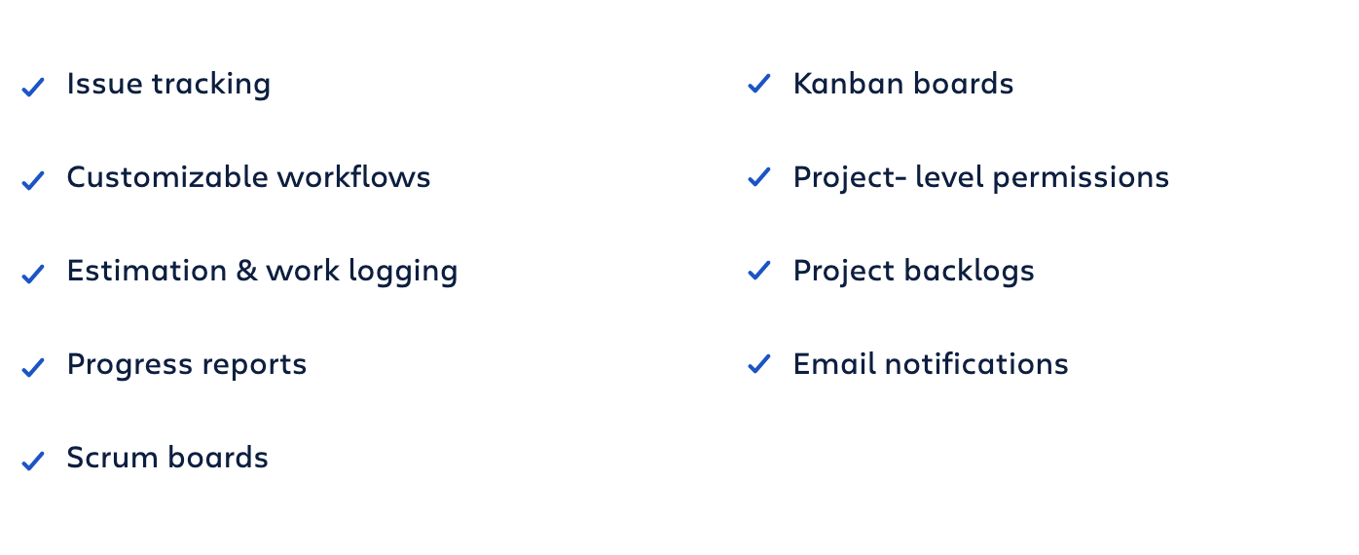
Why JIRA is Used?

Slide 4
Jira for project management teams

Slide 5
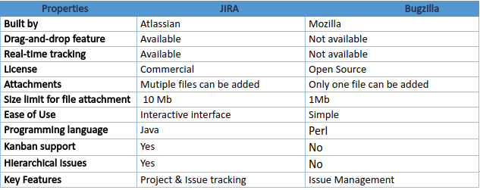
JIRA Vs Bugzilla

Slide 6
How to Use Jira for Test Case Management
Jira Software was not designed to serve as a Test Case Management.
It can be configured to support test case management in a couple of different ways.
You can use one of the dozens of apps available in our Atlassian Marketplace.
Zephyr
TMT https://marketplace.atlassian.com/categories/test-management

Slide 7
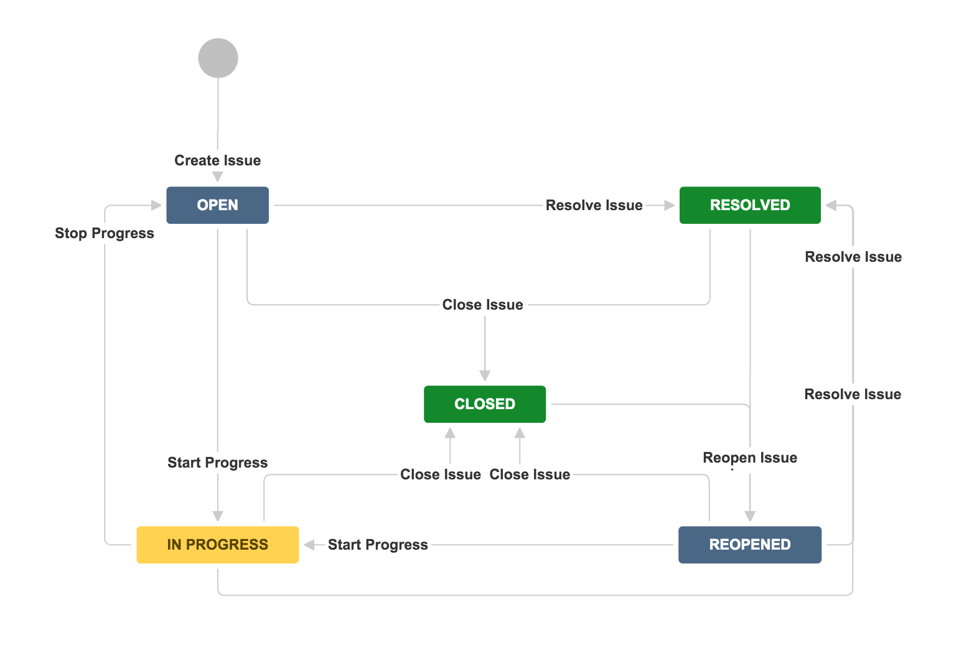
What is WorkFlow in JIRA?
The path that your issues take is called a workflow.
Jira workflow is composed of a set of statuses and transitions that your issue moves through during its lifecycle, and typically represents work processes within your organization.

Slide 8
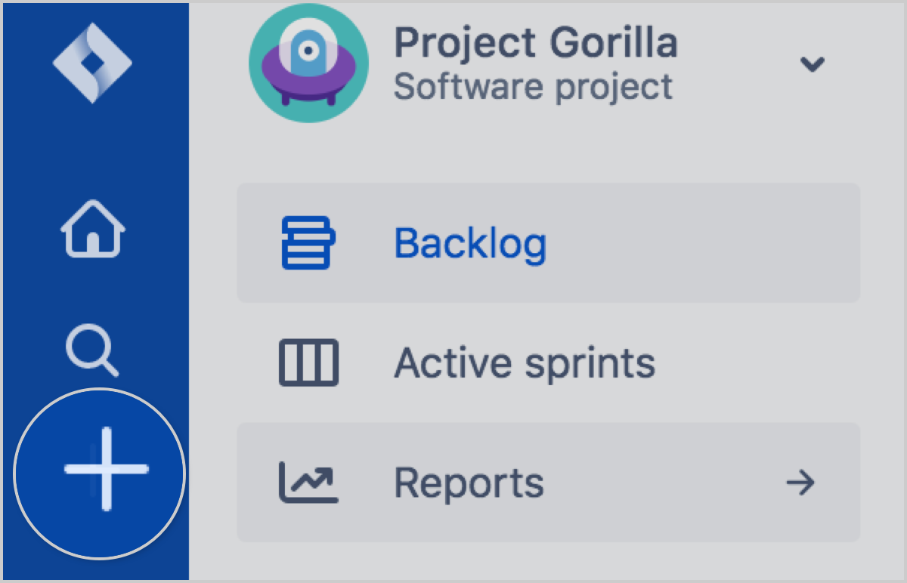
What is an Issue in JIRA?
Teams use issues to track individual pieces of work that must be completed.
an issue could represent a project task, a helpdesk ticket, a leave request form,

Slide 9
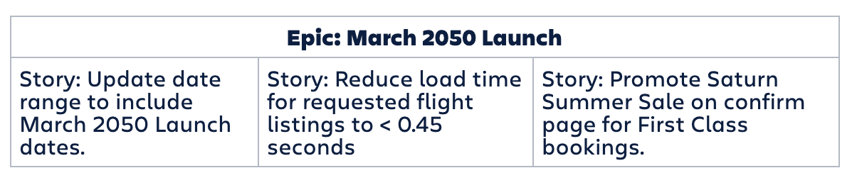
What is Epic?
Epic is a body of work that can be broken down into specific tasks (called user stories) based on the needs/requests of customers or end users.

Slide 10
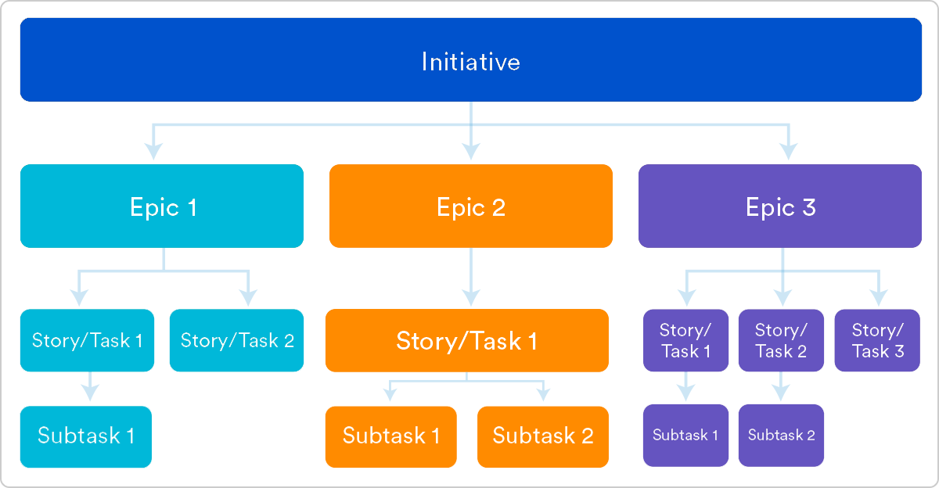
What is Epic?

Slide 11
What is Story?
A user story is an informal, general explanation of a software feature written from the perspective of the end user or customer.

Slide 12
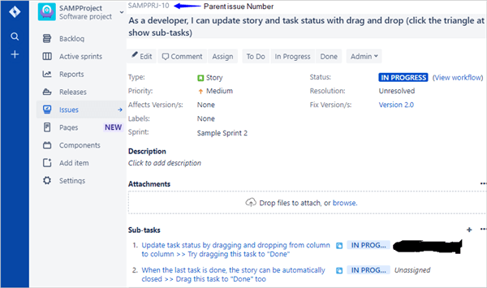
What is Task and SubTask?
Action Item, Further breakdown of Task is Subtask.

Slide 13
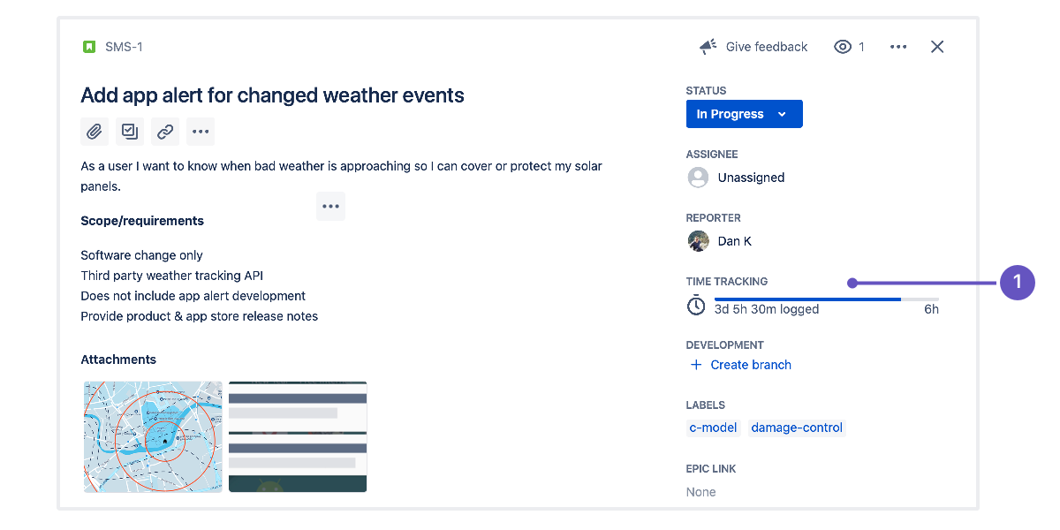
What is Time Tracking in JIRA
Time tracking lets your team record the time they spend working on issues. It's enabled by default in Jira; you won't lose any existing data if you disable or re-enable it.

Slide 14
What is Time Tracking in JIRA
Time tracking lets your team record the time they spend working on issues. It's enabled by default in Jira; you won't lose any existing data if you disable or re-enable it.

Slide 15
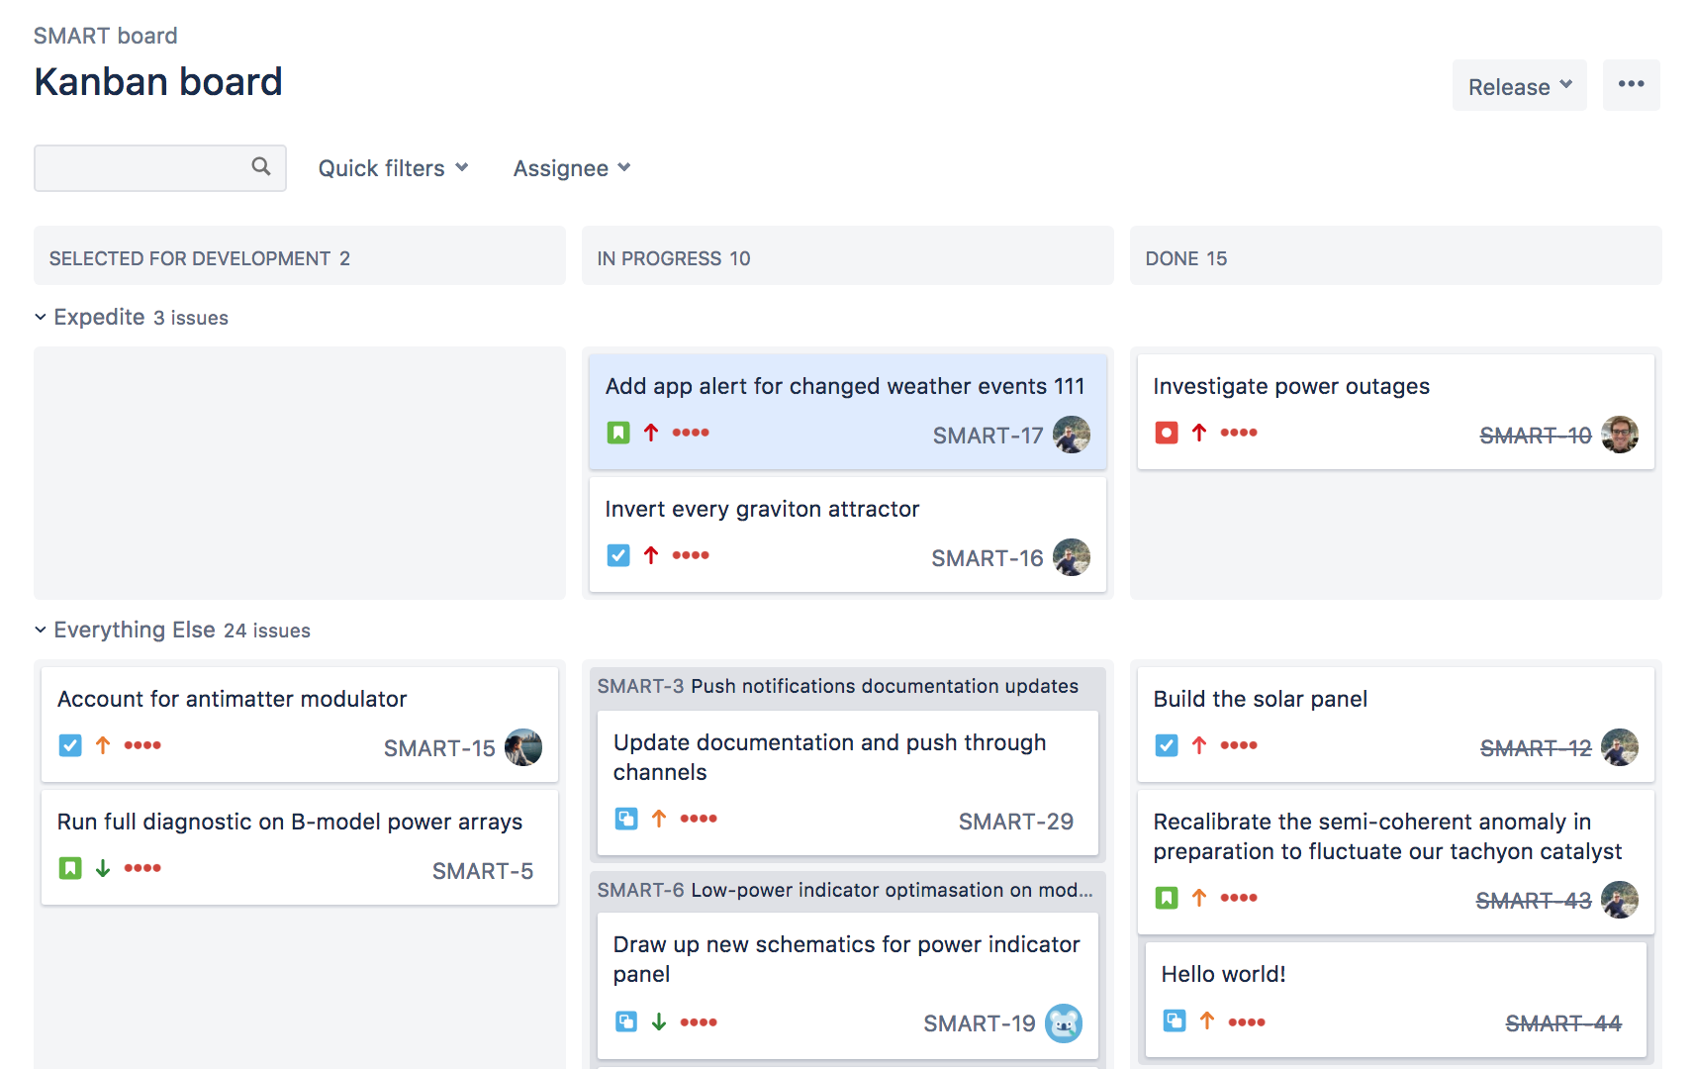
What is Kanban Board?
A kanban board is an agile project management tool designed to help visualize work, limit work-in-progress, and maximize efficiency (or flow)

Slide 16
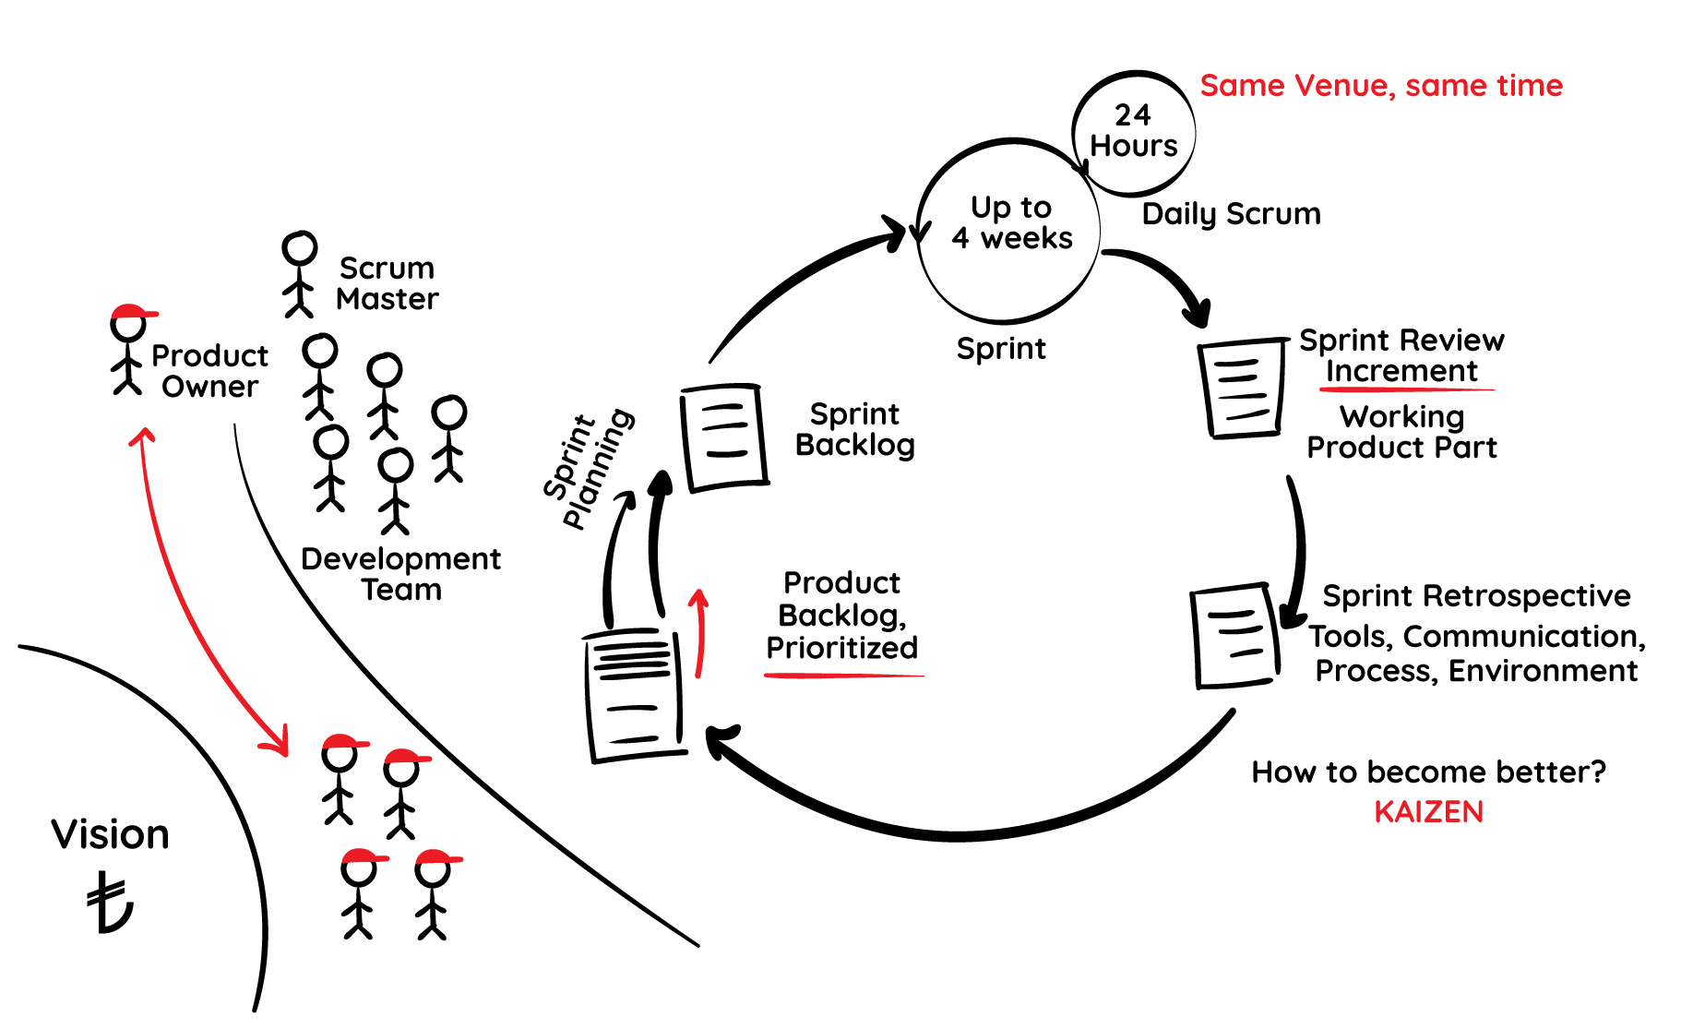
What is Scrum?
Scrum is a framework within which people can address complex adaptive problems, while productively and creatively delivering products of the highest possible.

Slide 17
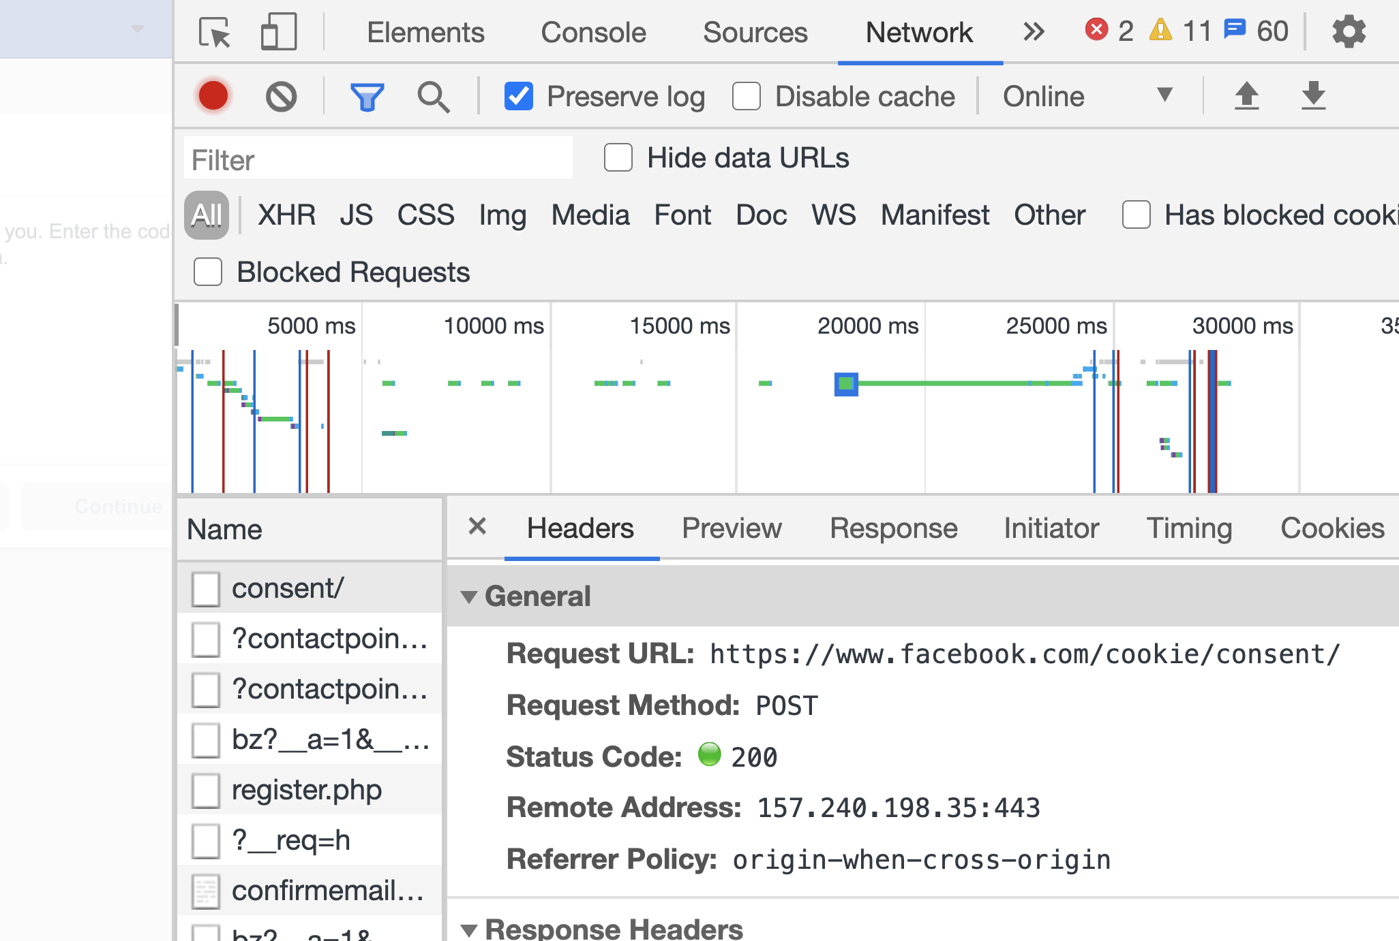
Task for Day 3
Find the FREE APIs list over the internet which you want to work on.
Open Facebook.com and check in Chrome Developers Tools, Different HTTP METHODs when you create a Post in Facebook.

Slide 18
Issues Types
https://confluence.atlassian.com/adminjiracloud/issue-types-844500742.html

